Slide 1
JAVA ARCHITECTURE - Muthu Jeya. K - Bharathi. M - Sharmila. S - Priyadharshini. R - Revathy. B - Narmidha. M

Slide 2

There are three main components of Java architecture 1. JVM 2. JRE 3. JDK

Slide 3
JAVA VIRTUAL MACHINE
JVM consist of class loader and JIT interpreter
It is used to convert byte code to binary code
JVM has the following tasks:
- Load code
- Verify code
- Execute code

Slide 4
JAVA RUNTIME ENVIRONMENT
It provides libraries and resources for runtime
It plays a key role while executing any java application
The JVM is a part of JRE.
This is like JVM, platform-dependent.
It allows Java Application to run without development tools

Slide 5
JAVA DEVELOPMENT KIT
It includes Development Tools to provide an environment to develop your Java programs and JRE to execute your java code.
In order to create, compile and run Java program you would need JDK installed on your computer.

Slide 6
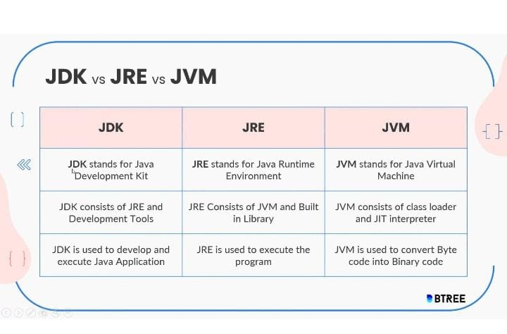
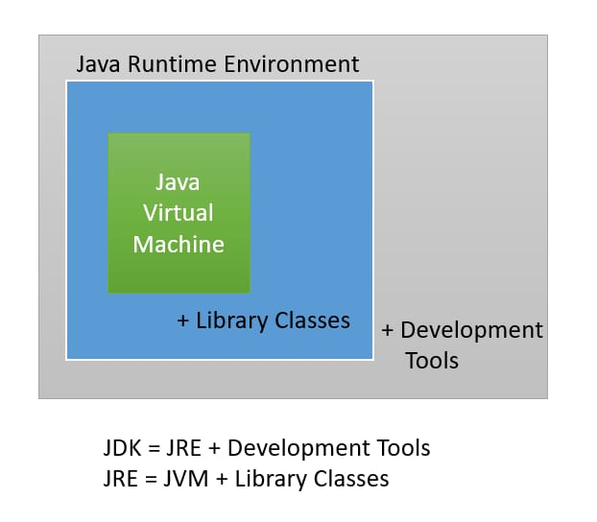

Slide 7
APPLICATIONS
STAND ALONE APPLICTAION
WEB APPLICATION
ENTERPRISE APPLICATION
MOBILE APPLICATION

Slide 8
thank you

